Slide 1

MotoProg
Capstone Project Phase 2
Advisor:Naomi Unkelos-Shpigel
Students:
Liran Haim 308292382
Sapir Dayan 313605776

Slide 2

The problem
The problem we are trying to solve is the issue of low motivation and engagement among students when it comes to studying and learning academic material and especially in the software world.
Notes:
1-When students do not find interest in the study material, they may be in a state of significant lack of knowledge. These days we are all distracted.
smartphones and the internet are catching our attention.
Although, there are many platforms on the Internet that the user can learn through, but during the learning process the user can lose interest and motivation. This will mean that the learning process may not be effective, the learner will not feel obligated to the learning process.
2-Today Due to the rapid growth of information and communication technologies, the education environment has been enriched with technologies and become more diversified.
In Software engineering there are topics that are less interesting or alternatively more
difficult to understand, this can negatively affect the motivation of learners .
In our days there are many systems that can teach the user on any subject and particularly in programming and in software engineering but most of these applications/webs don’t check the user's motivation through the learning process.

Slide 3
Our system
“MotoProg” is a web application that was designed to solve this problem.
Checking the user’s Motivation
Teach hard software principles
Using Gamification
Using The
WOLF
Questionnaire
Cross- Platform
Notes:
Our system is divided into categories, each category presents questions in the specific topic. Each question had a unique ID.
Our platform checks the motivation of the user during his learning progress. This check done by presenting the user 3 questions from the Wolf questionnaire.
To increase the user's motivation through the process we use "Gamification Mechanisms". In our system it is done by:
Points- are accumulated because of answering correct on the questions. The system presents the user his score during all the process, the user can see it during his learning process.
Ranking -the questions in each category
Hint – when the user tries to answer a question, he can use the icon light that appears on the question screen, clicking on the icon will remove an option from the answers and advance the user to the solution.
50:50 - In every question screen there is an option to 50:50. The 50:50 is presented by the icon in the right side of the screen, clicking on the icon will remove half of the options from the answers.
users are all participants – employees or clients (for companies), students (for
educational institutions).
The WOLF Questionnaire is a popular tool used in psychology and research to assess individuals' beliefs and attitudes towards work, occupation, and career development. The questionnaire consists of 80 items that measure nine different dimensions of work orientation, including achievement orientation, future orientation, social orientation, and work ethics. Participants are asked to rate the extent to which they agree or disagree with each statement on a Likert scale. The WOLF Questionnaire has been shown to be a reliable and valid instrument for assessing work-related beliefs and attitudes, and can be used in various settings, such as career counseling, vocational guidance, and organizational research.
Our system offers the user the opportunity to give feedback on each question in
the chosen subject.
Using the user's answers on the WOLF questions through the quiz the system will examine his motivation.

Slide 4
Gamification
“The use of game elements and game-design techniques in non-game contexts‘’
[by Werbach and Hunter]
Use of game design elements in non-game contexts
Gamification has also been a central part of the design of many mobile applications for smartphones and tablets, in the quest to achieve stronger user engagement.
Notes:
The key element of gamification is the inclusion of tasks that learners must perform. The performance of tasks leads to accumulation of points, transition to higher levels, and winning awards.

Slide 5
Our system
The general flow of the system
Choosing a category
Presenting unique question from this chosen category
The user answers the
questions
The user rates each question from 1-5
Scale
In the end of the quiz the system presents statistics and data regarding the user’s performance.
In case that the user has been identified as unmotivated – The user can change category.
If the system detects a lack of motivation
The system presents the Wolf research screen

Slide 6
Checking the user’s Motivation Algorithm
The user's response to each question is followed by a rating on a 1-5 scale, indicating their level of interest or enjoyment.
The system evaluates the user's rating for the last 3 questions by comparing it with the ratings given by the all users.
When the user's total rating is lower than the general rating, the wolf questionnaire will be presented to the user.

Slide 7
Checking the user’s Motivation Algorithm
Checking the user’s Motivation Algorithm
The user needs to rate the statements from the research.
Rating that is lower than the threshold rating, the system suggests moving to a different category.
If the rating is equal to or higher than the threshold rating, the system continues with the same quiz.

Slide 8
WOLF Questionnaire
We base our system goal on research that its central goal was to develop a new instrument for the measurement of flow experiences at work.
The WOLF questionnaire is an initial set of 16 elements that were used to operationalize flow.
This collection was trimmed to 13 questions that divided to three parts:
Absorption (4 items),
job enjoyment (4 items),
intrinsic work motivation (5 items).
On a seven-point scale, respondents stated how often they encountered elements of flow
(1 = never, 7 =constantly).
Bakker, A. B. (2008). The work-related flow inventory: Construction and initial validation of the WOLF. Journal of vocational behavior, 72(3), 400-414
Notes:
The check of the user's motivation will be through the WOLF questionnaire.
We changed the wording of the questions to match them to our system.
The user will need to rate the statements after each pool of questions in a specific subject – on a 7 points scale.
Through the user's feedback we will analyze and get a perspective about his motivation in the specific quiz / pool of questions.
Absorption is a term used to describe a state of total focus in which employees are completely absorbed in their task. T

Slide 9
The rank | The meaning | In percent
1 | “Never” | 0%
2 | “Almost” | 16.6%
3 | “Sometimes” | 33.2%
4 | “Regularly” | 49.8%
5 | “Often” | 66.4%
6 | “Very often” | 83.33%
7 | “Always” | 100%
The Rating of
The statements
From the
Wolf
Research
Bakker, A. B. (2008). The work-related flow inventory: Construction and initial validation of the WOLF. Journal of vocational behavior, 72(3), 400-414

Slide 10
The Threshold
Absorption: the user needs to get at least 18.7%.
Work enjoyment: the user needs to get at least 28.3%.
Intrinsic motivation: the user needs to get at least 20.9%.
Those factors based on the Wolf research.
The user must get the minimum in every part of the questionnaire, in order to declare him motivated.
Bakker, A. B. (2008). The work-related flow inventory: Construction and initial validation of the WOLF. Journal of vocational behavior, 72(3), 400-414

Slide 11
Choosing The Questions Algorithm
Upon the user's selection of a category, the system arranges all questions within the category based on their respective ratings.
In order to ensure that the user is presented with a high-rated question at random and that it has not been previously attempted, the system shuffles the questions in groups of ten.

Slide 12
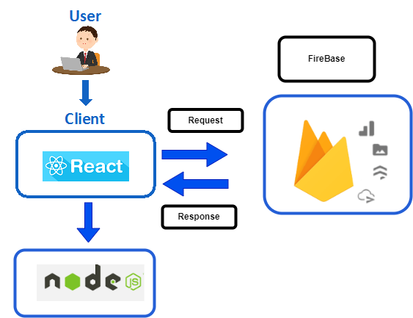
Our system
Software Architecture Diagram
Notes:
\

Slide 13
System’s environment
Used to develop our user interface
Used to develop the backend infrastructure.
Used to manage all the data of the system

Slide 14

Demo Video

Slide 15
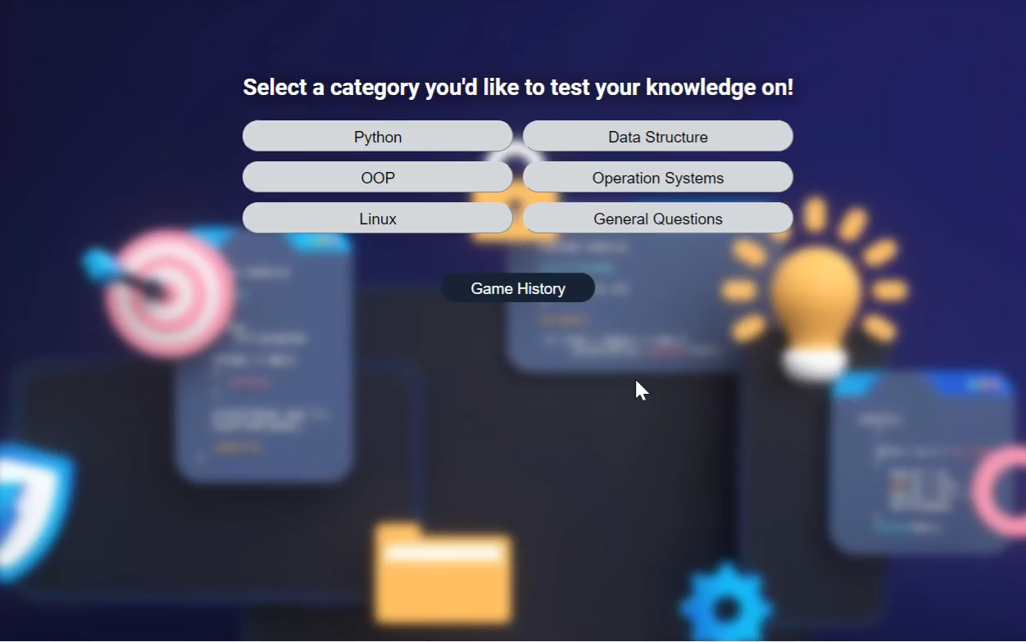
Demo Video

Slide 16
Summary
Our project offers a new and innovative platform for software learning.
It inspired by the Wolf Research approach and involves gamified elements, which considers user motivation and engagement to deliver a more personalized and effective learning experience.

